Slide 1
The Seven Big Ideas of Computer Science
Presented by: Lilla Ball

Slide 2
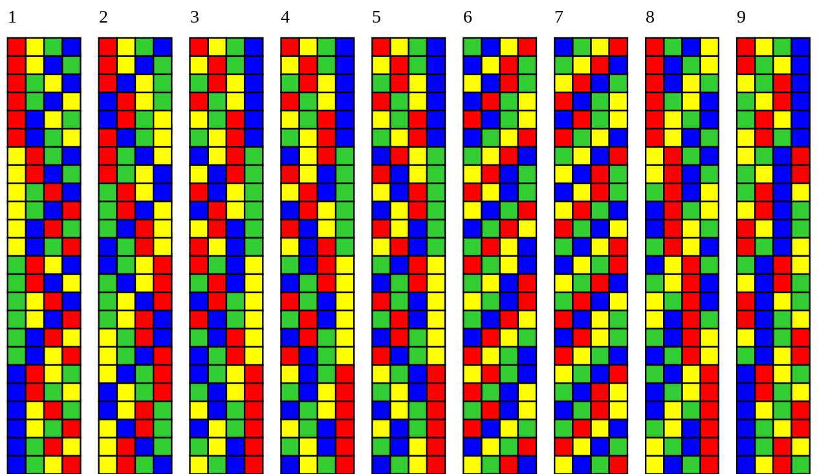
Algorithms
-Algorithms: Informal definition- Steps to solving a problem.
=Examples: =Following a recipe
= Following driving directions
-Algorithms: Formal definition-An ordered set of unambiguous, unexecutable steps that defines a terminating process.
Algorithms may solve many computational problems but cannot solve all of them.

Slide 3
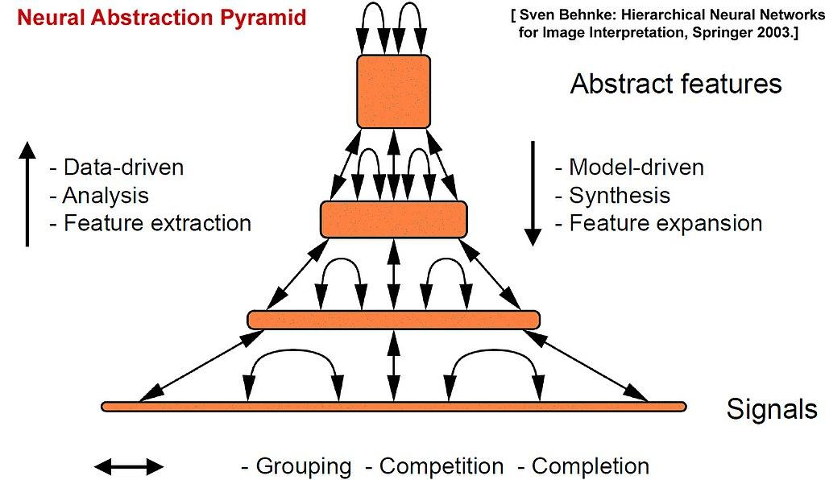
2. Abstraction
-Distinction between: The external properties of something and the details of its internal composition
-Allows the design and manufacture of of complex computer systems, use of “abstract tools” allows study of:
=How components interact with other components at the same time
-How a collection of components form a larger component
-How larger components form the whole system

Slide 4

3. Creativity
-Hardware and software systems require creative thought to:
-Design a system
-Solve specific problems and abstract problems
-Test solutions
-Imagine new, novel systems and uses

Slide 5
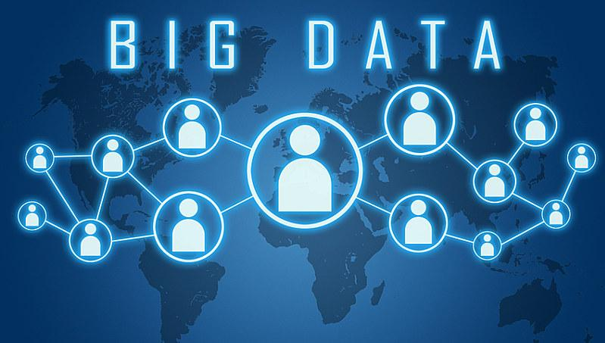
4. Data
-Algorithms process or transform digital data
-Different Kinds of Digital Data:
-Text -Graphics -Video
-Numeric Data -Sound
-Issues
-How to digitize analog data -How to efficiently store data
-How to prevent data errors -Effect of ever-increasing amount of available data

Slide 6

5. Programming
Programming is the translation of an algorithm into executable code. The ability to code is a fundamental skill for computer scientists.
-Phases of computer program development:
-Understand the problem
-Design an algorithm to solace the problem
-Enter the program and save
-Execute the program
-Test the program , find eros and debug, then retest
-Document and evaluate the program

Slide 7
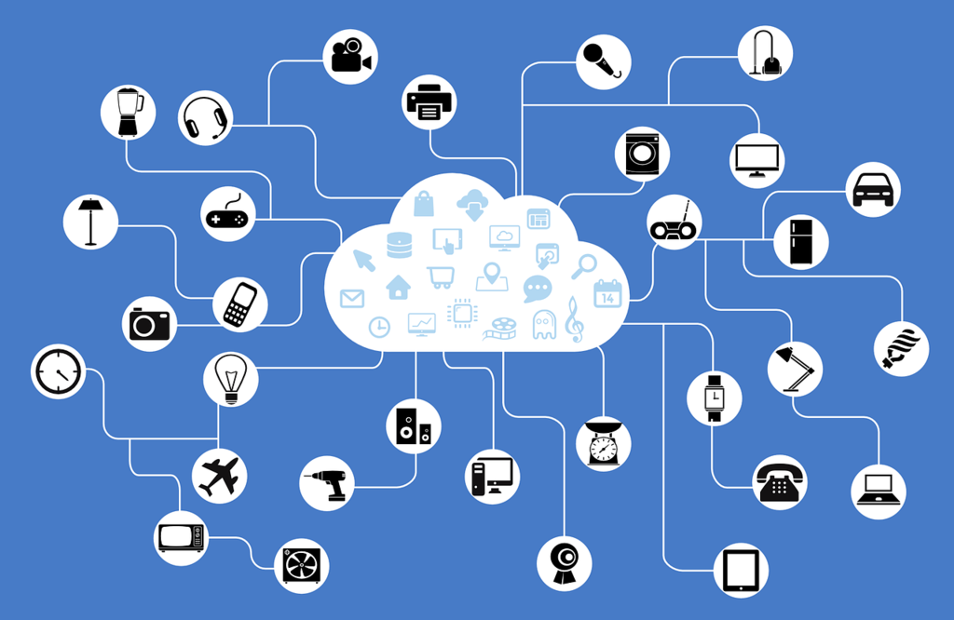
6. Internet
The internet connects computers and electronic devices around the world
-Affects many aspects of our lives including:
-Commerce -Education -Transportation
-News -Health -Defense
-Entertainment -Law
Profound impact on privacy and security-Growing importance of cryptocurrency and cybersecurity

Slide 8


7. Impact
-Computer science has a direct impact on:
-Technology
-But also many other aspects of our lives such as:
-Social
-Ethical
-Legal

